Slide 1
Semantic Segmentation on Camvid Dataset
Foundations of Deep Learning Project – AA 2023/2024
Cristian Longoni (871070)
Robin Smith (839696)
Sergio Verga (859200)

Slide 2

Outline of the presentation
Introduction
Exploration and pre-processing
Model from scratch
Pretrained models
Results analysis
Conclusions and future perspectives

Slide 3


Introduction
Task: semantic segmentation on CamVid dataset
Multi-class, single-label
Model from scratch
Architecture inspired by UNet
Pretrained models
MobileNetV2
DeepLab
Dataset splitting (701 istances)
401 images for training
150 for validation
150 for test

Slide 4
Dataset exploration
701 images and labels: no duplicates found
32 semantic classes in total – Void class indicates the unlabeled or uncertain pixels
Analysis of class distribution of the pixels
Class occurrence computation for each image

Slide 5
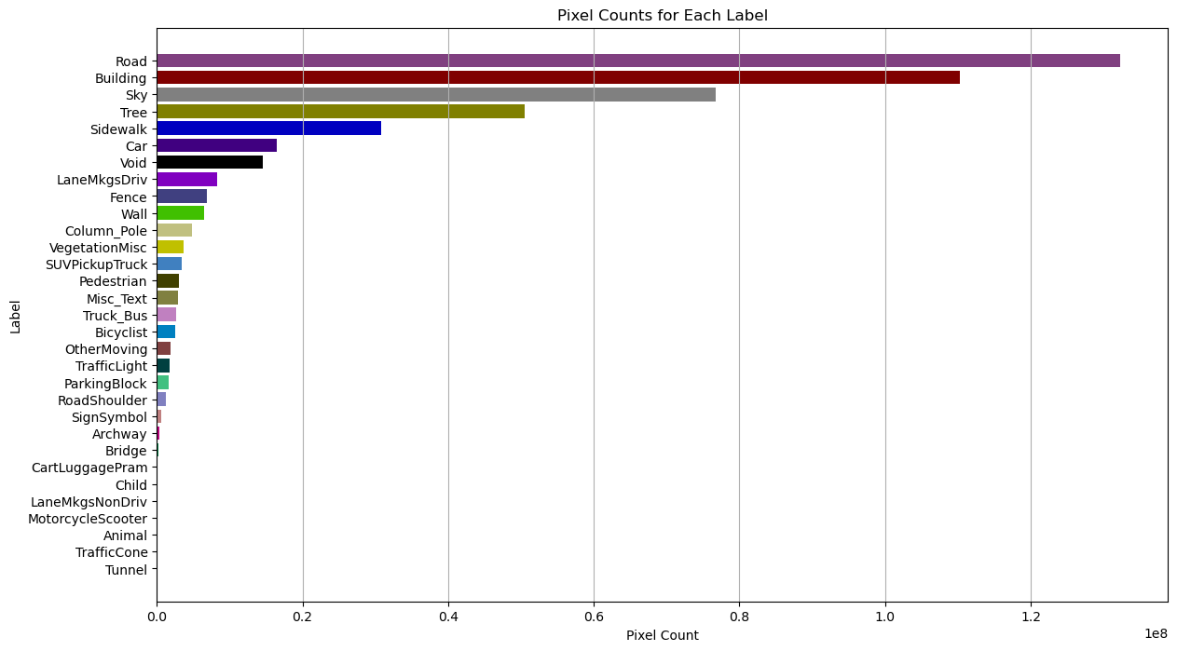
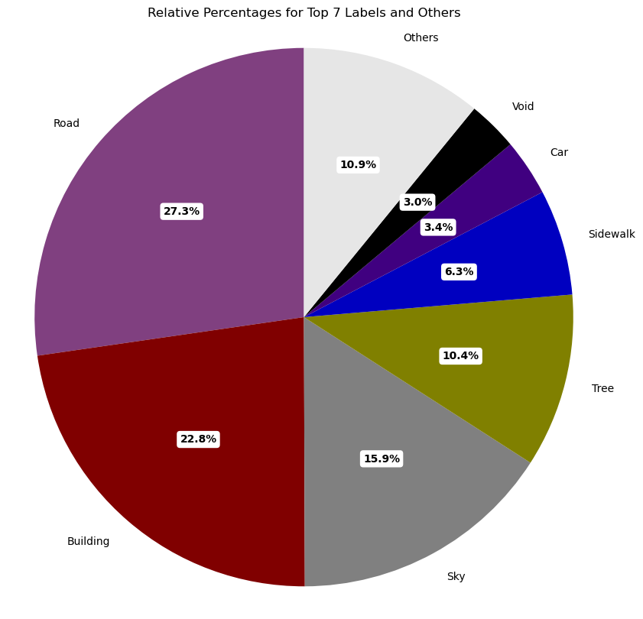
Pixel label counts and percentages within the dataset
Dataset exploration

Slide 6
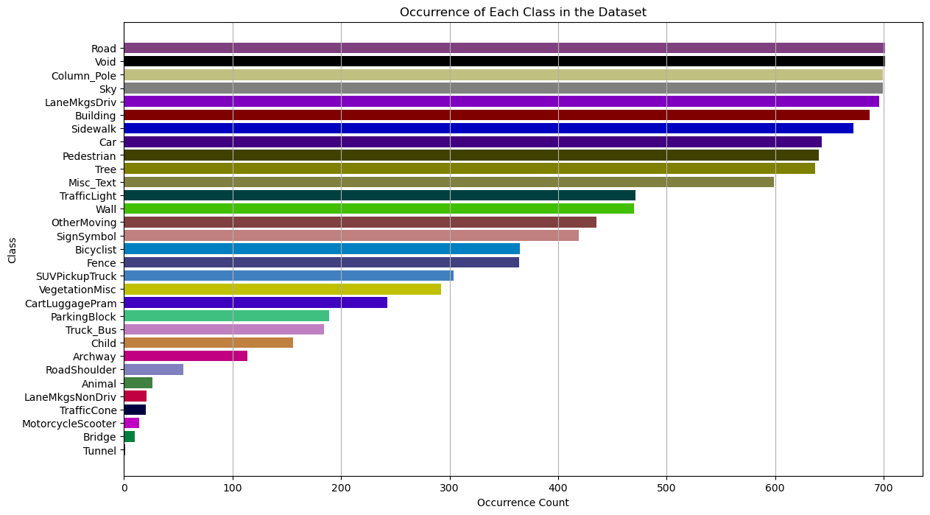
Class occurrence plot
Dataset exploration
Note:
Road and void labels appear in all the 701 images
Tunnel label appears in only one image

Slide 7
Dataset Pre-processing
Shuffle
Resize
Encode
Shuffling in unison images and labels to break temporal correlation.
Resizing from 960x720 pixels to 224x224 pixels with:
  Bicubic interpolation for raw images
  Nearest neighbor for labels
Encoding labels assigning each RGB triple to a class index.
One-hot-encoding to be further used for metrics compatibility.

Slide 8
Model from scratch

Slide 9
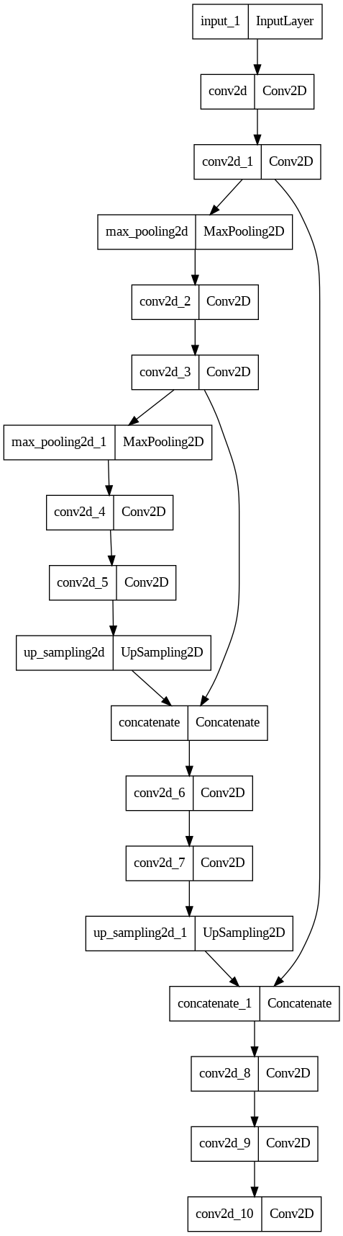
Unet inspired architecture
  Augmentation
  Regularization
  Batch size
  Activation functions
  Optimizers
Optimization
Architecture
  Fully convolutional
  Encoding path
  Expansive path
  Skip connections

Slide 10
Unet inspired architecture
Architecture
Optimization
Fully convolutional
Encoding path
Expansive path
Skip connections
Augmentation
Regularization
Batch size
Activation functions
Optimizers

Slide 11
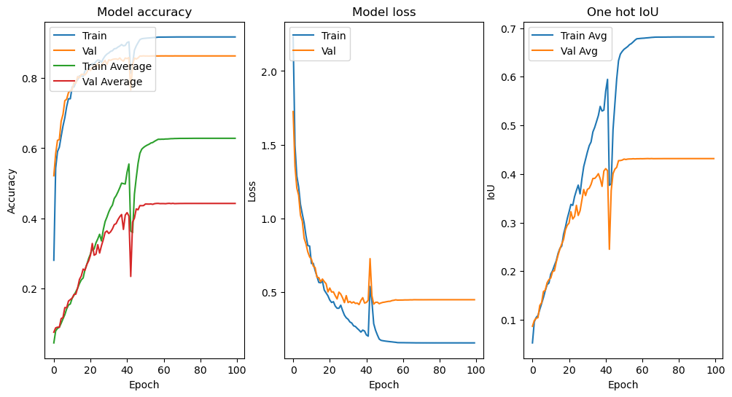
Unet
Base version
The evaluation of the model is based on:
Overall pixel accuracy
Mean pixel accuracy
Mean IoU

Slide 12
Unet
Base version
Batch size = 8
Epochs = 100
LR=0.001 (can vary on training)
Loss: categorical crossentropy (with mask)
Optimizer: Adam
Activation: ReLU

Slide 13
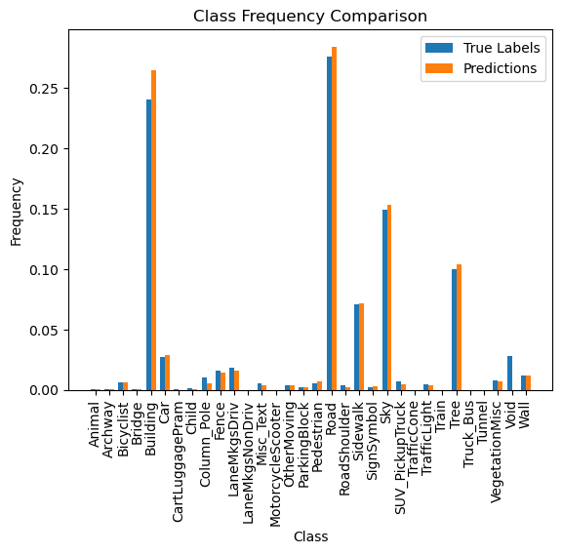
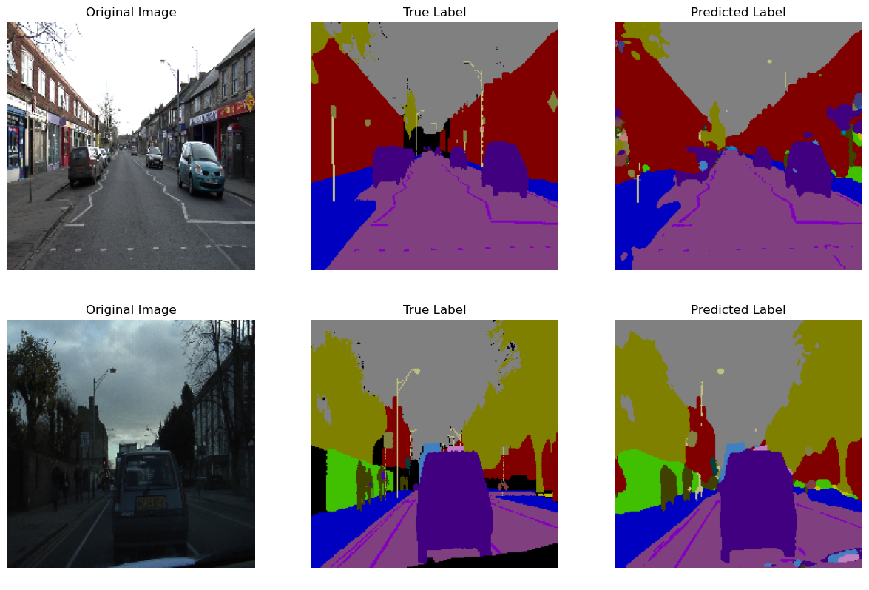
Predictions
Visualization
Note: Void class is masked

Slide 14
Data Augmentation

Slide 15
Data augmentation
Implementation is performed through a Custom Class, in order to augment both raw images and labels.
Applied operations:
Brightness
Contrast
Saturation
Gaussian noise
Random flip
Crop (and resize)
Rotate (and resize)
Note:
Operations in blue preserve the label, operations in red do not.
Cropping and rotation are applied with different interpolations
Resizing performed to avoid handling black edges

Slide 16
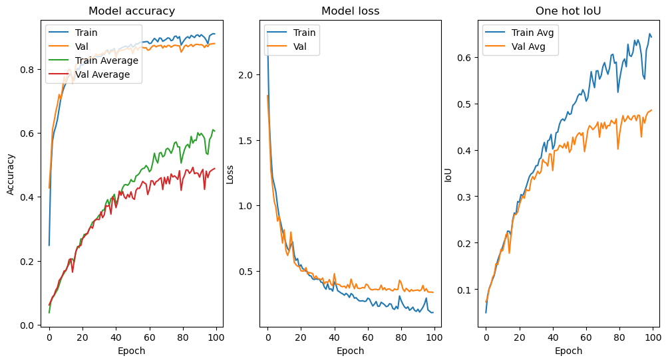
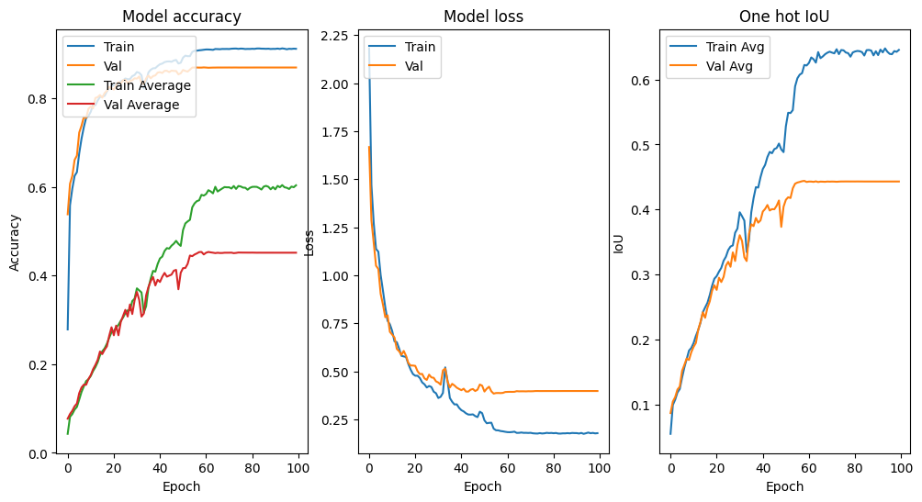
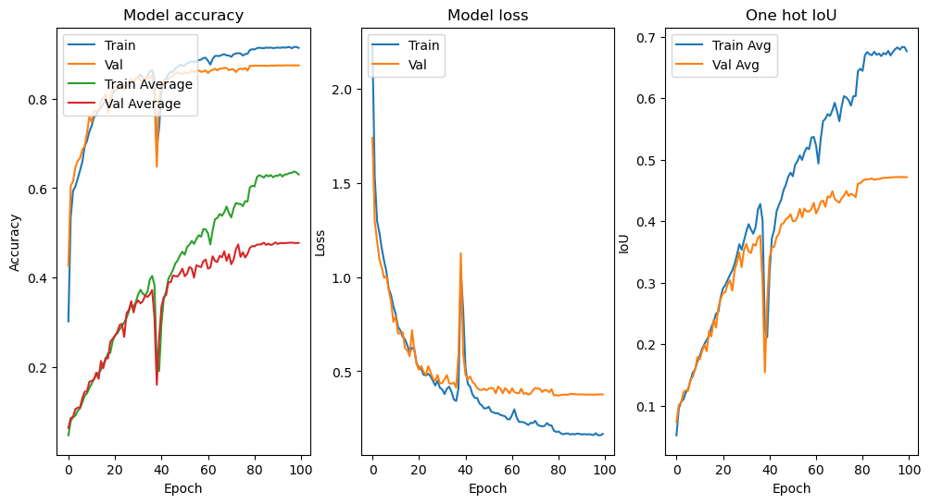
Data augmentation
Base Version
Crop
Horizontal flip
Rotate

Slide 17
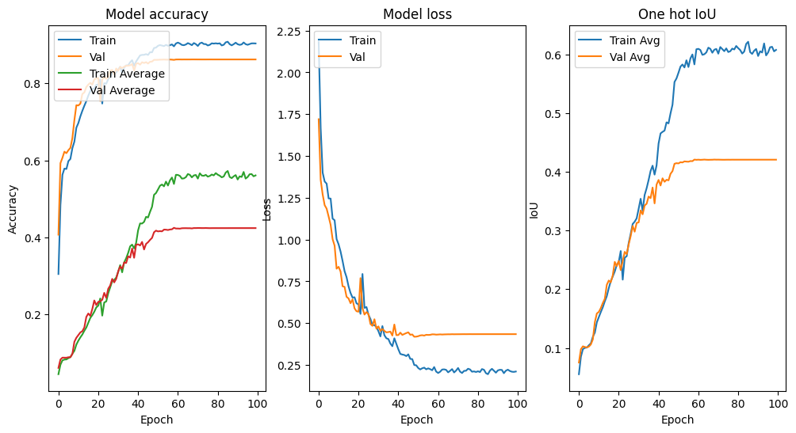
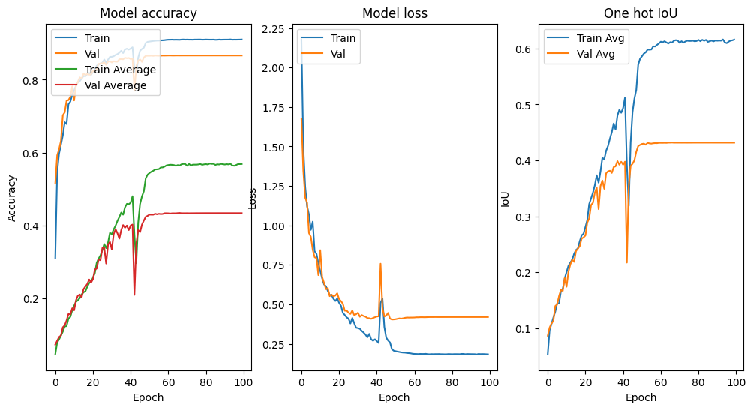
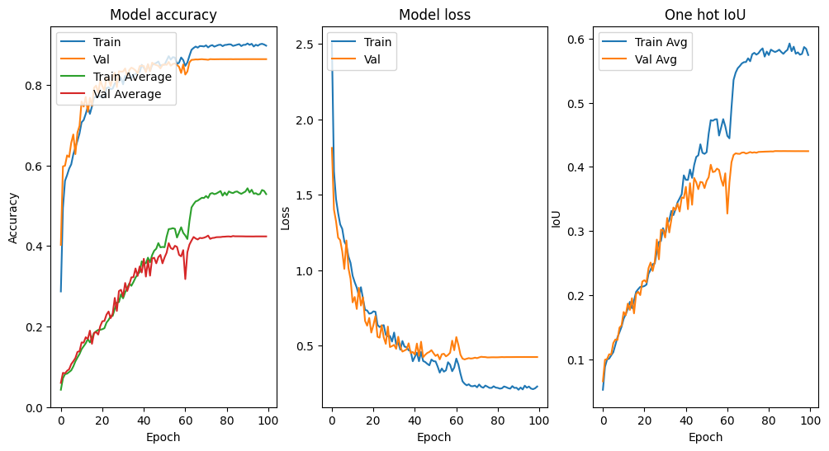
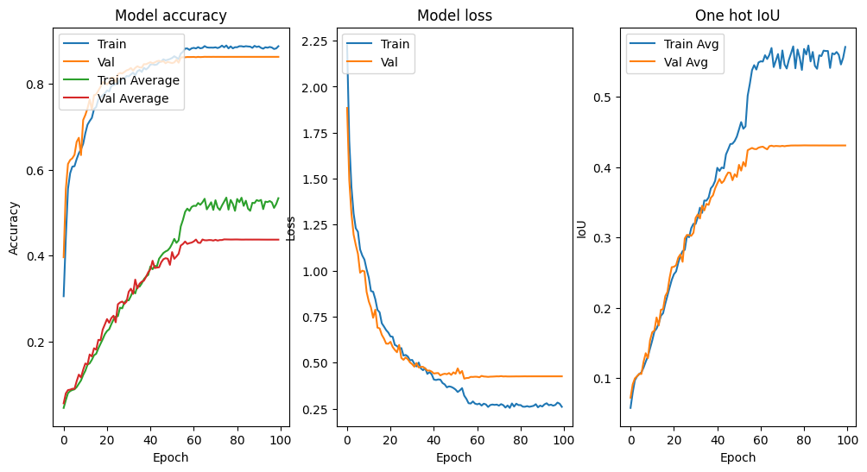
Data augmentation
Brightness
Saturation
Contrast
Gaussian Noise

Slide 18
Data augmentation
Base Version
Crop
Rotate
Gaussian Noise

Slide 19
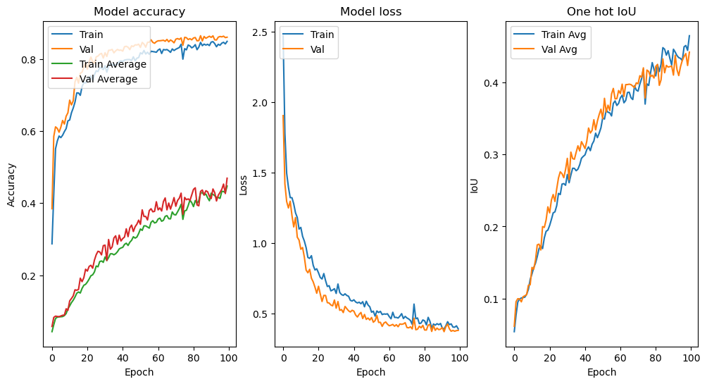
Final result with co-application of the three best DAs
Data augmentation
We apply the best 3 performing DAs together: CROP, ROTATION, GAUSSIAN NOISE.
The overfitting phenomenon is significantly reduced.

Slide 20
BAYESIAN OPTIMIZATION
Bayesian optimization algorithm was used to find the optimal combination of:
Starting learning rate – 0.01, 0.001, 0.0001
Batch size – 4, 8, 16
Optimizer – Adam, RMSProp
Epochs number – 25, 50, 100
The result of such a process is the following:

Slide 21
Hyperparameters OPTIMIZATION

Slide 22
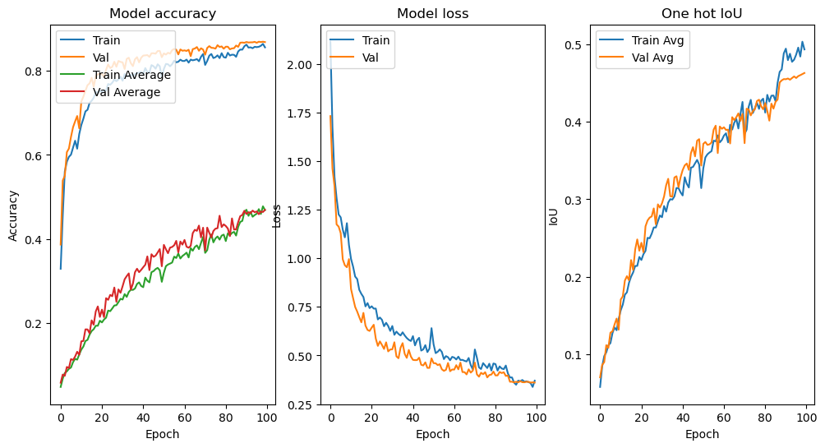
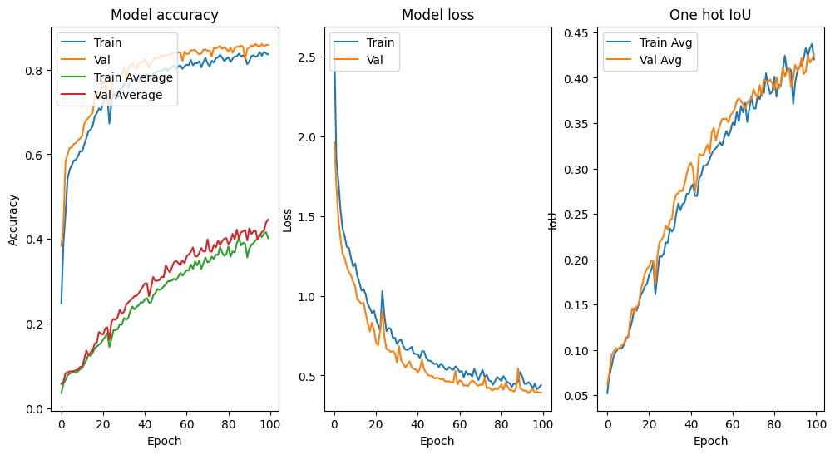
batch sizes
Different values of the batch size are implemented
Batch size=4
Batch size=8
Batch size=16

Slide 23
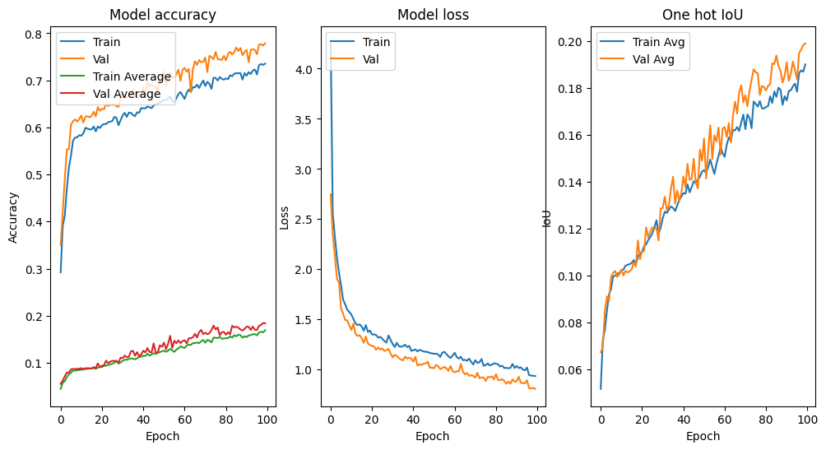
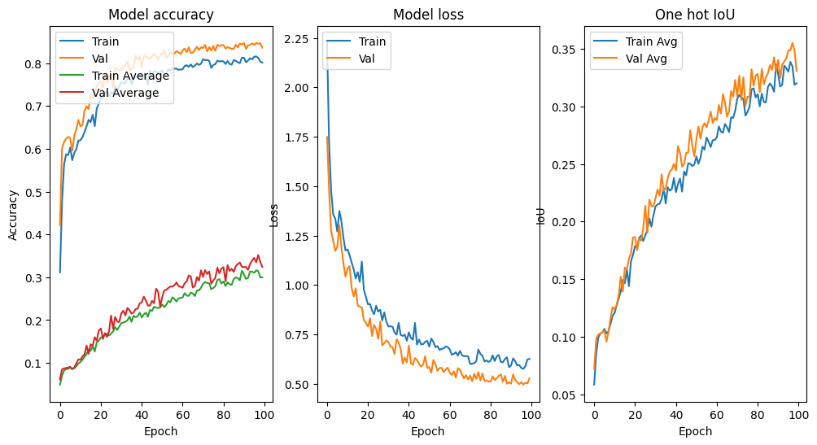
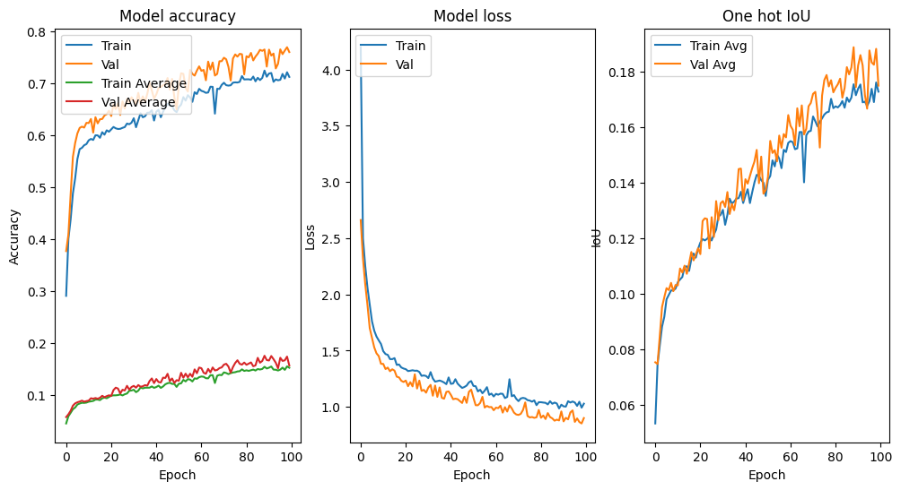
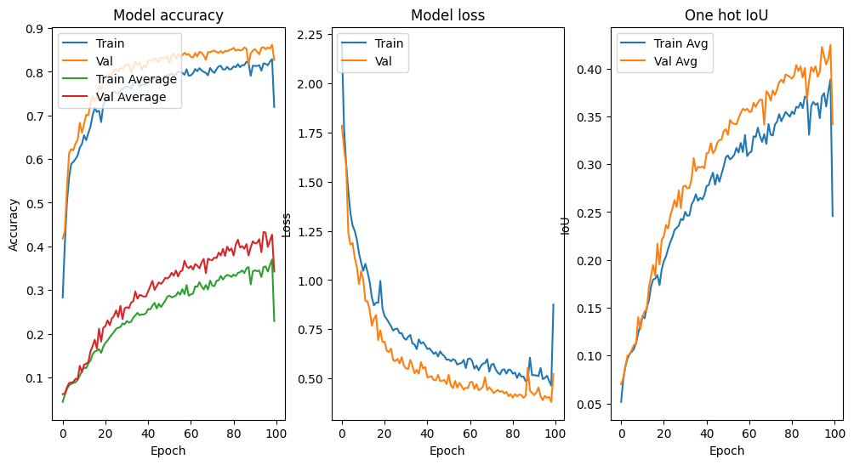
Regularization
L1 (Lasso Regression)
L2 (Ridge Regression)
L1L2 (both penalties)
Dropout

Slide 24
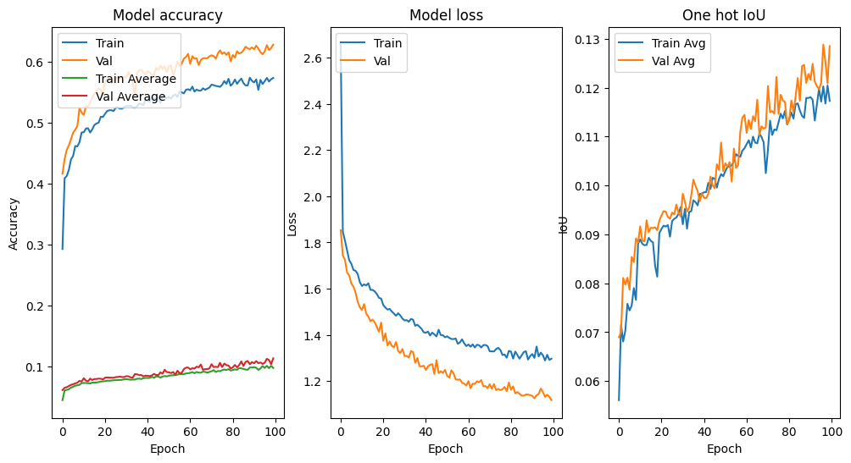
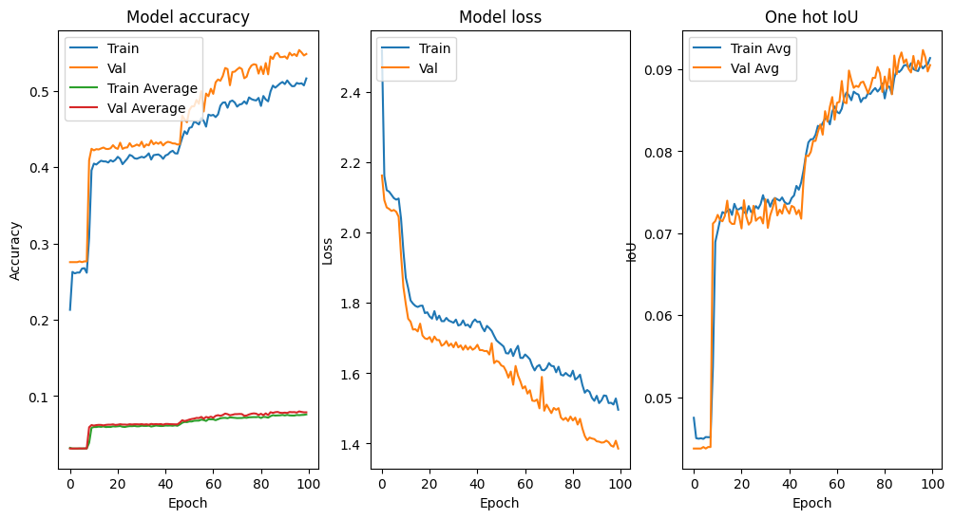
Activation functions
Sigmoid/Tgh activation function experimented as an alternative
Dropped due to poor performances
Sigmoid activation function
Tanh activation function
Future perspectives: trainable activation functions

Slide 25
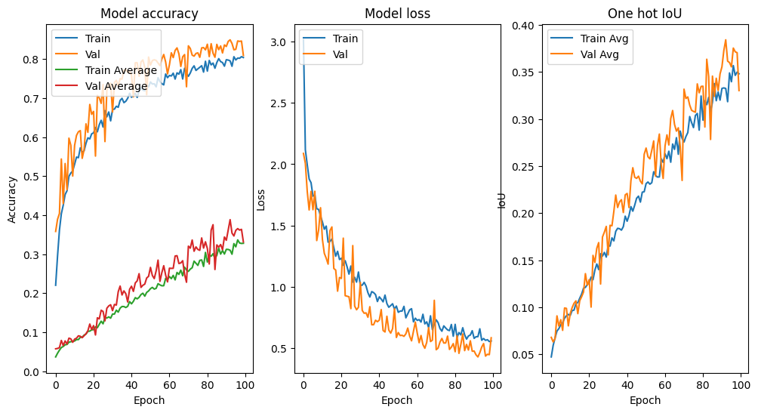
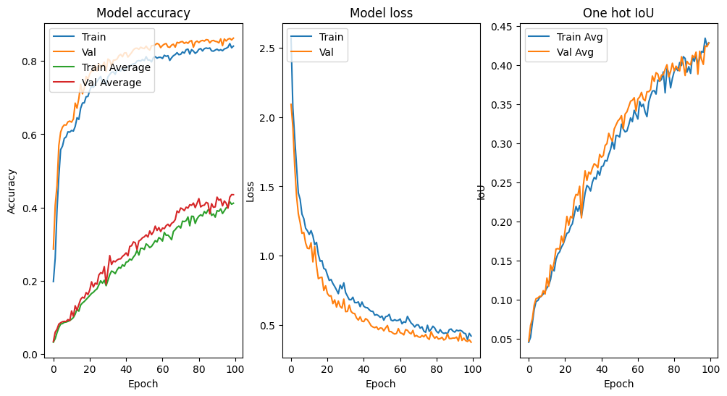
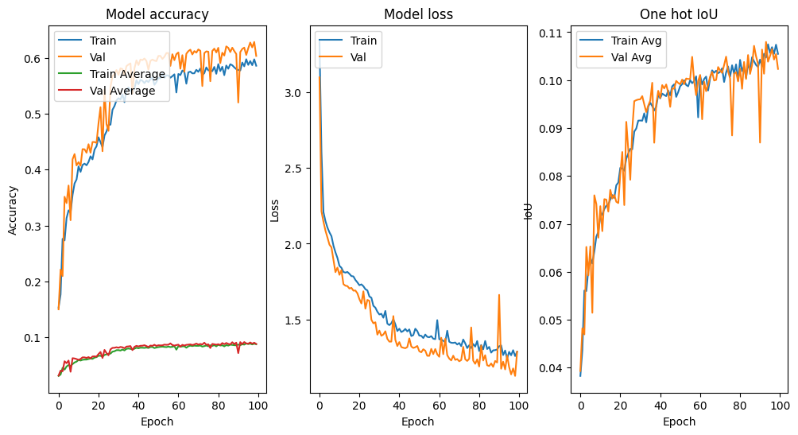
OPTIMIZERS
Different optimizers are experimented
RMSprop
Adam
SGD

Slide 26
Pretrained models

Slide 27
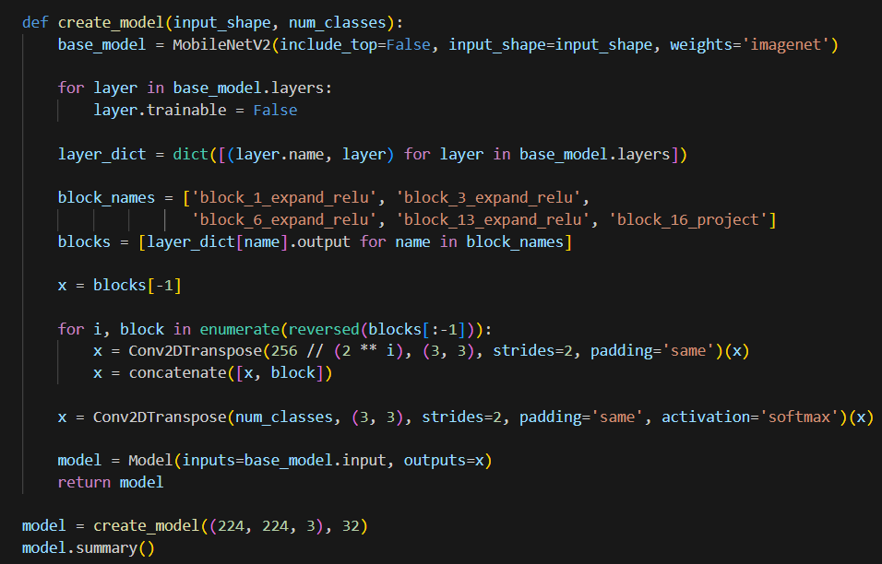
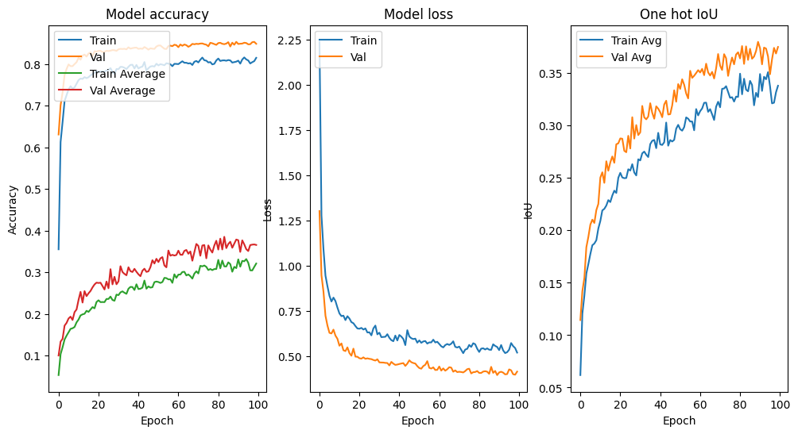
MobileNetV2
Implemented through a MobileNetV2 pre-trained on ImageNet for the encoding path.

Slide 28
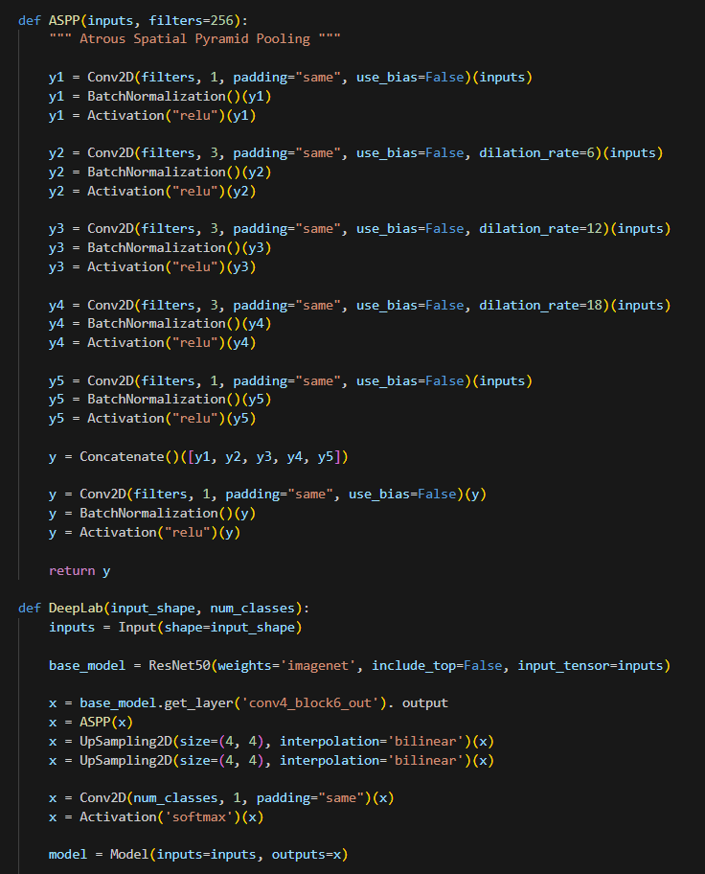
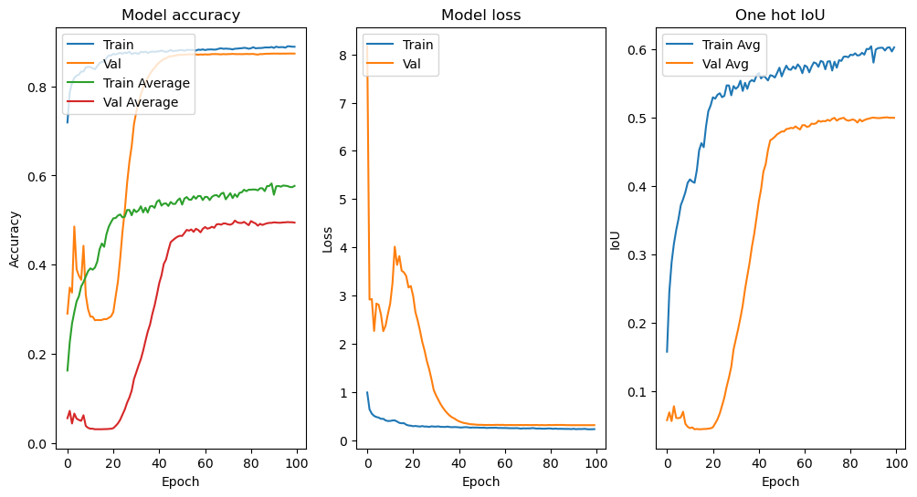
DEEPlab
Implemented through a ResNet pre-trained on ImageNet for the encoding path and ASPP (Atrous Spatial Pyramid Pooling)

Slide 29
Results

Slide 30
Model evaluation
The selected models are evaluated on the test set (composed of 150 unseen images).
The files .keras are read with the weights resulting from model training in the evaluation notebook
The decorator register keras serializable (and after deserializes) the custom metrics and the loss function

Slide 31
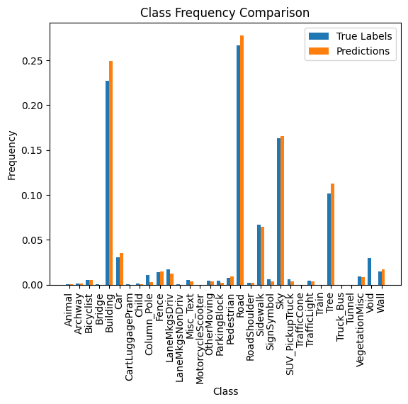
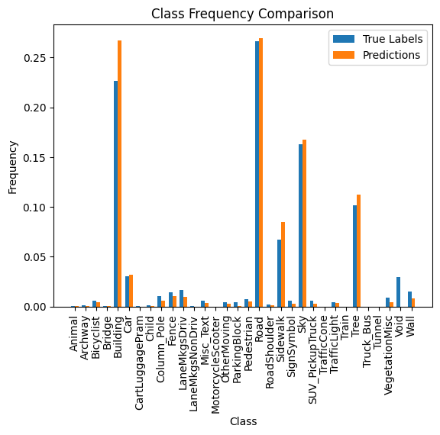

Histograms
UNet
MobileNetV2
DeepLab

Slide 32
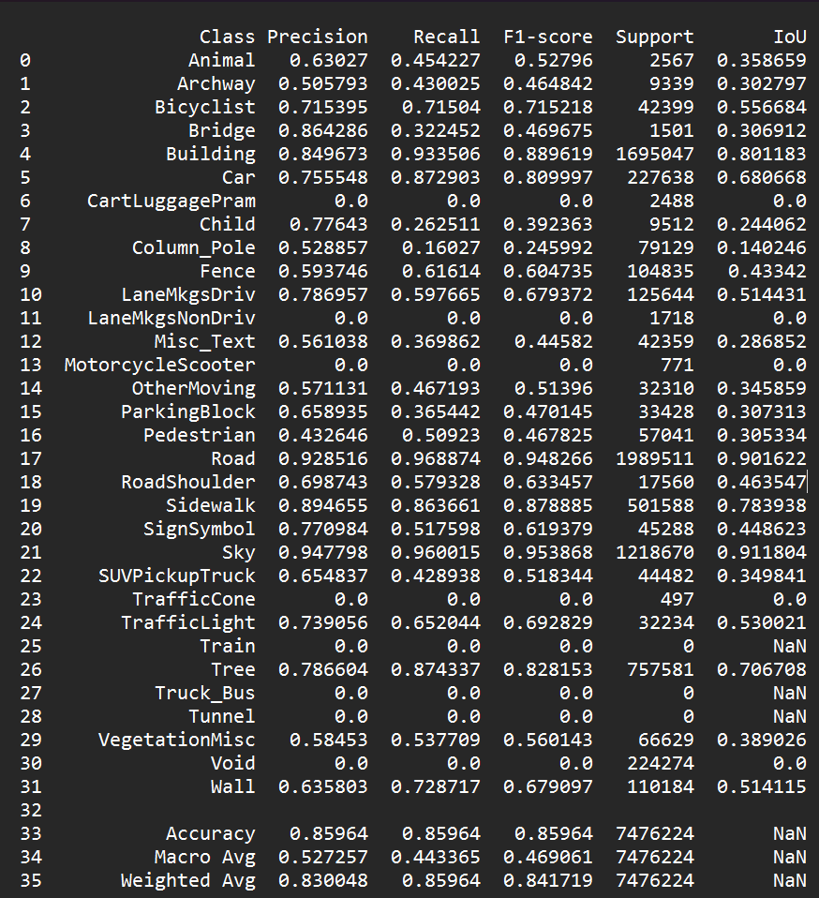
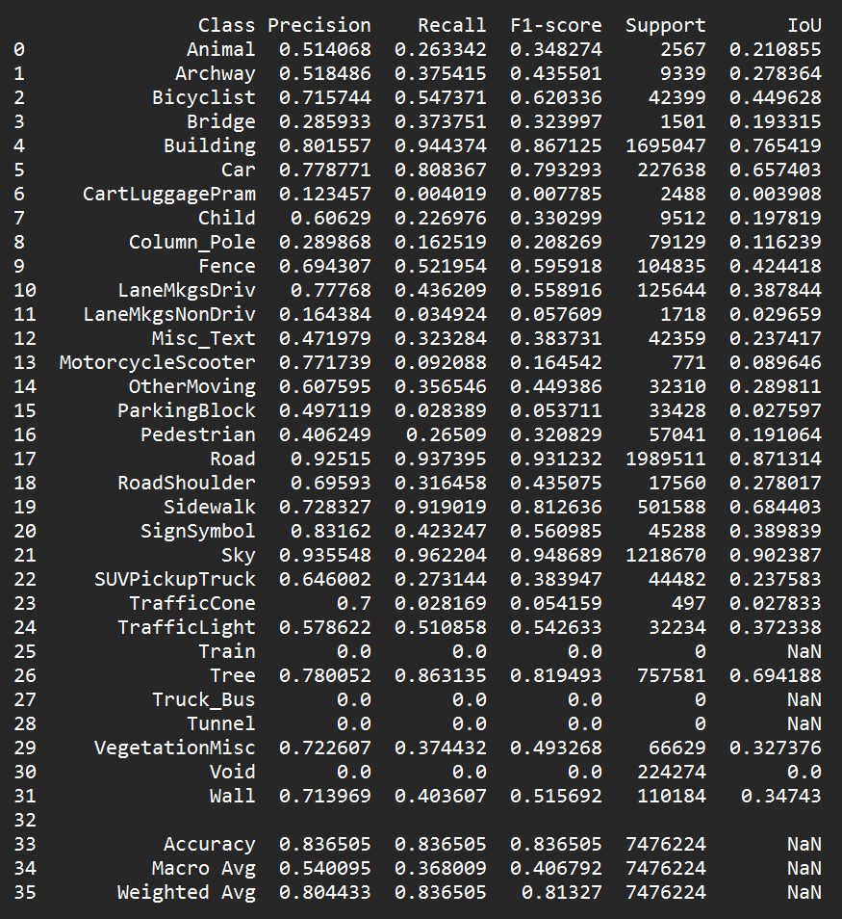
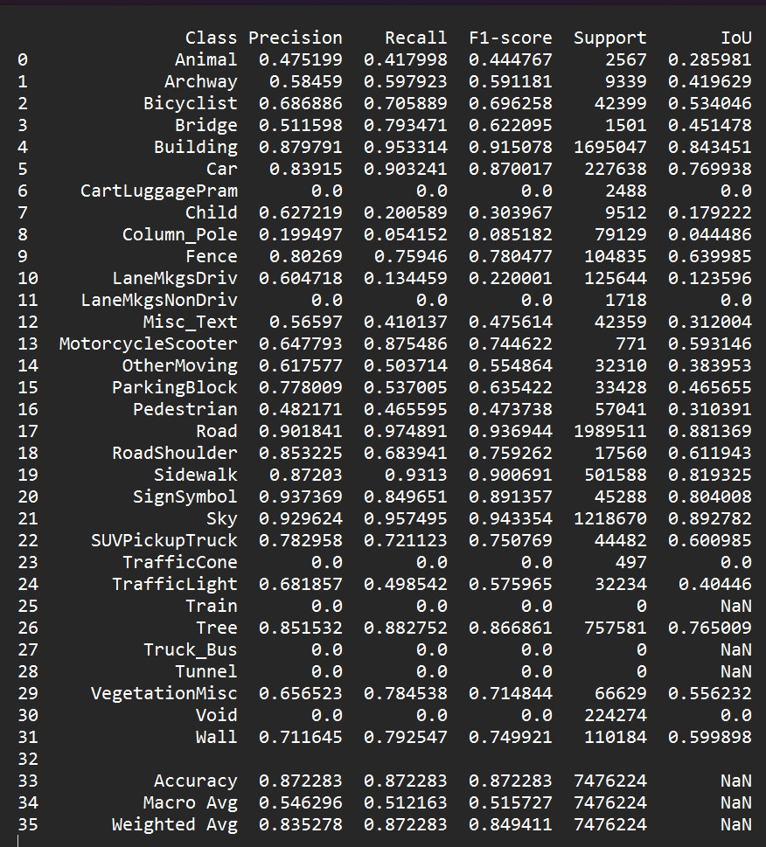
Classification reports
UNet
MobileNetV2
DeepLab

Slide 33
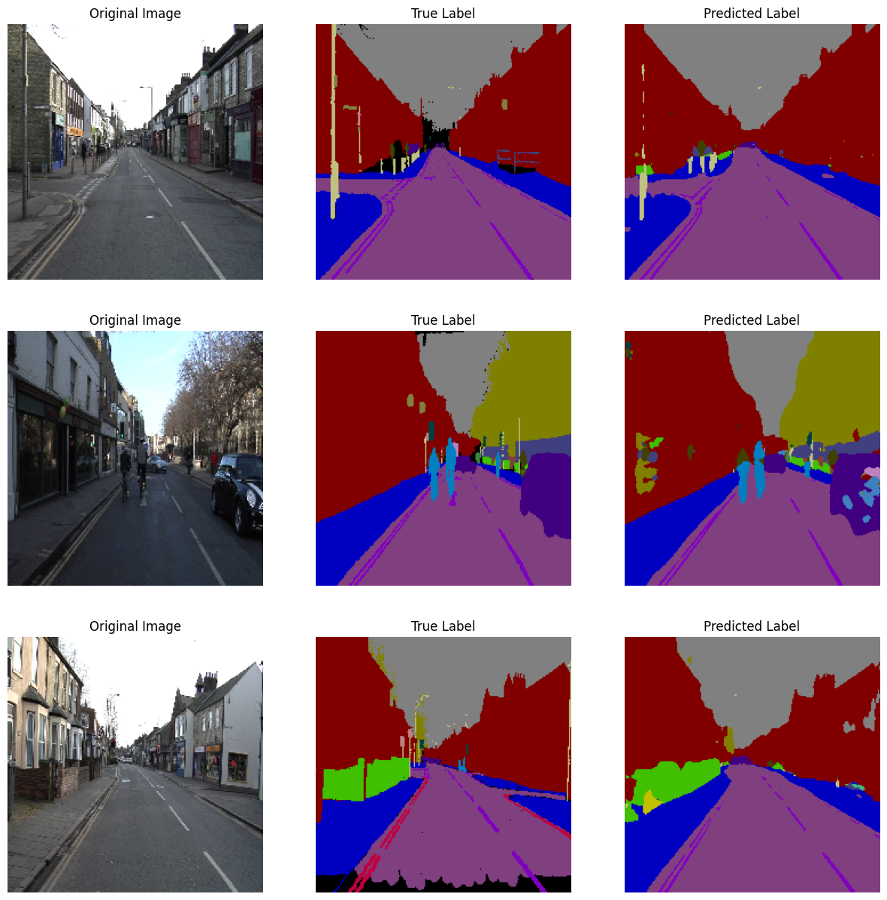
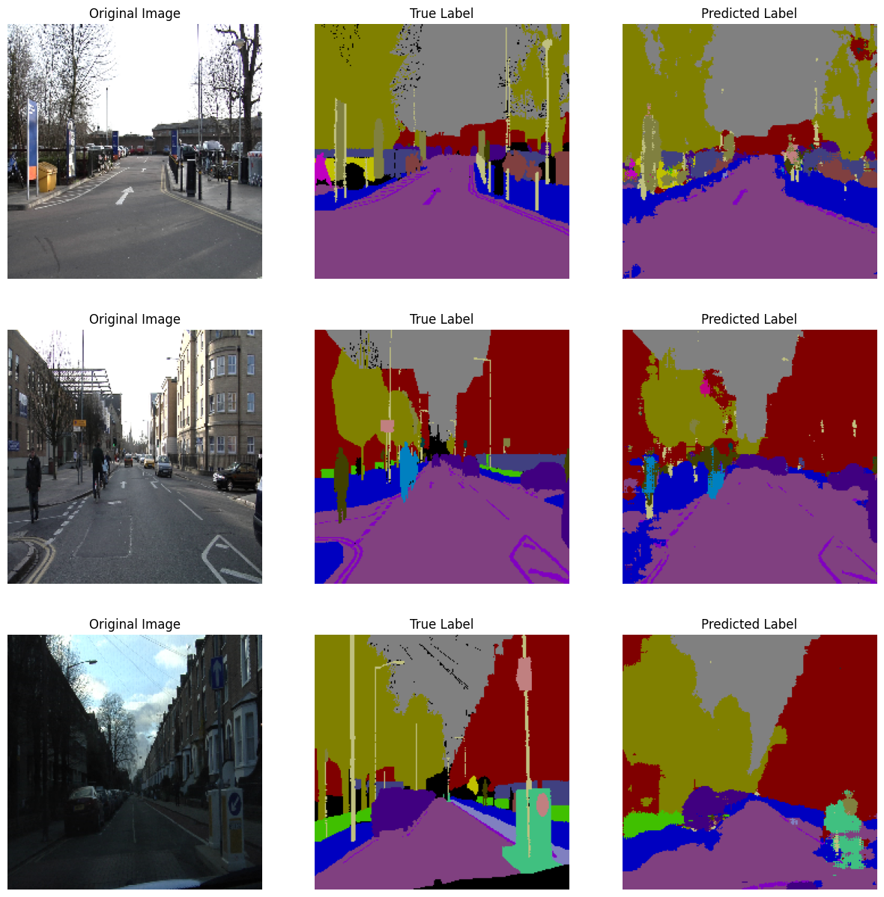
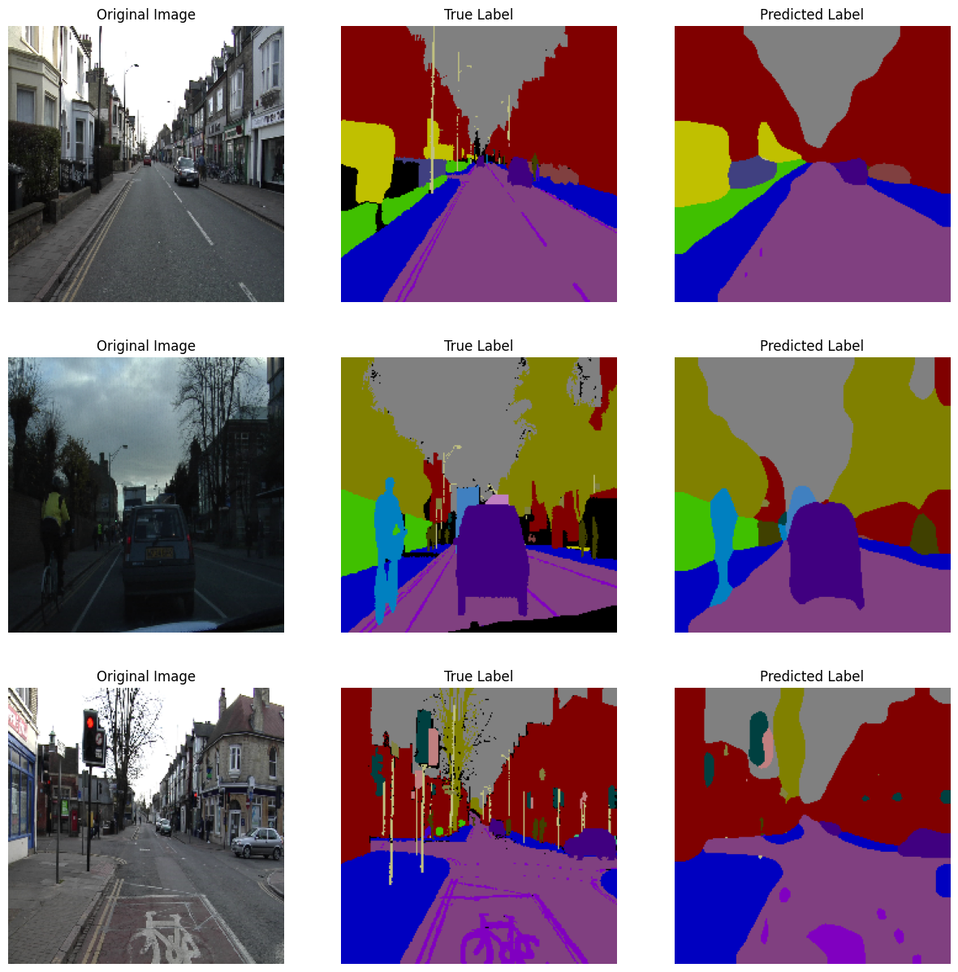
Models predictions
Samples visualization
UNet
MobileNetV2
DeepLab

Slide 34
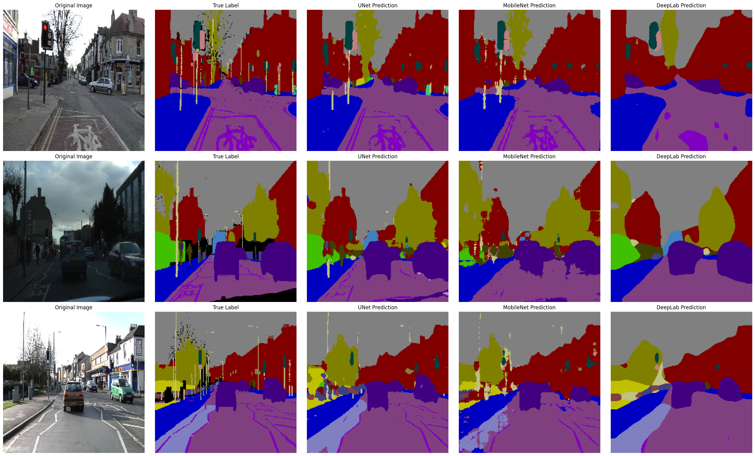
Models predictions
Overall comparison

Slide 35
Conclusions and future perspectives

Slide 36
Conclusions
DeepLab (mean IoU= 0.5242) performs in average better than Unet (0.4507) and MobileNetV2 (0.3836)
Powerful feature extractor of DeepLab allows the minimal confusion between different object classes, w.r.t. Unet and MobileNetV2.
Hard for the models to distinguish between similar and rare classes.
All models struggle with shadowed areas and regions with complex backgrounds.
The easiest objects to classify are uniform, large ones, characterized by high contrast.
MobileNetV2 is optimized for low computational tasks, pretrained on structurally different natural images and not tuned as Unet is.

Slide 37
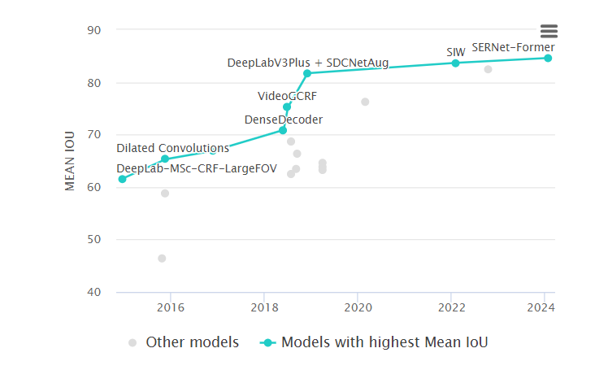
Future perspectives
Trainable activation functions
Combinations of data augmentations and ClassMix
Hyperparameter optimization via CV or Bayesian optimization
In-depth analysis of model inference on Void class
Implementation of other models

Slide 38
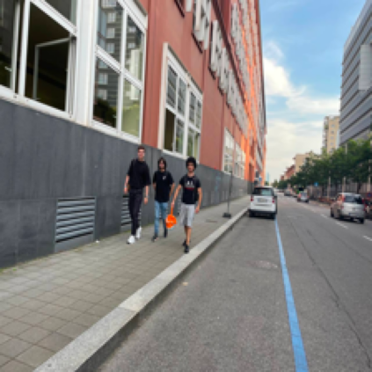
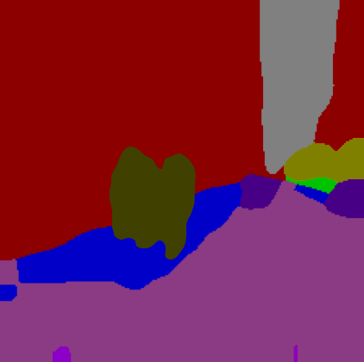
Thank you for your attention
Robin
Smith
Sergio Verga
Robin Smith
Cristian Longoni

